Slide 1
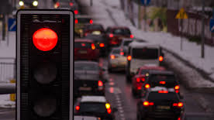
IMAGE RECOGNITION FOR TRAFFIC SIGNS
Linear Algebra and Matrix Analysis
Group 4
Angela Teng, Alan Chen,
Tam Nguyen, Jessie Hung
June 2019

Slide 2

OUTLINE
Problem Statement
Proposed Solution
Linear Algebra Application
Simple Example
Future Recommendations
2

Slide 3
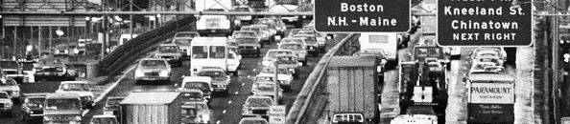
Problem Statement: Safety & Efficiency
In densely populated cities like Chicago and San Francisco, innovative modes of transportation are becoming more popular--including autonomous vehicles and self-driving cars.
How do we ensure passenger and public safety in the age of automation?
With the increasing number of self-driving car producers, concerns about safety are increasing
Current test drives have been controlled at smaller scales, but as they expand, so do the risks
Self-driving cars increase the probability of road accidents
Potential failure to detect traffic signs can be fatal for pedestrians and other drivers
3

Slide 4
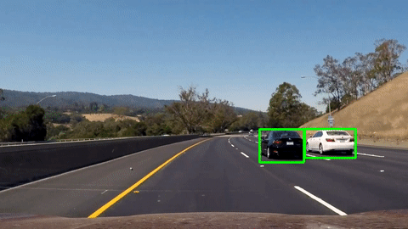
PROPOSED SOLUTION:
Traffic Image Recognition for Traffic Sign Identification
Many global auto manufacturers are actively exploring autonomous vehicle technology (GM, Ford, Volkswagen, Toyota, Tesla, Honda, Volvo, BMW)
The ability to detect signs correctly and follow traffic rules will increase safety immensely
4

Slide 5
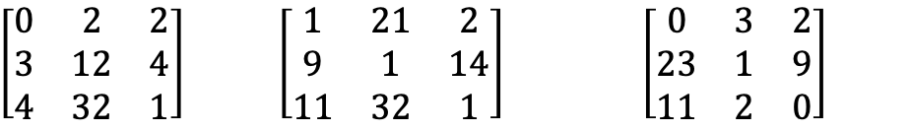
LINEAR ALGEBRA APPLICATION
$\left[\begin{matrix}0 & 2 & 2 \\ 3 & 12 & 4 \\ 4 & 32 & 1\end{matrix}\right]$ $\left[\begin{matrix}1 & 21 & 2 \\ 9 & 1 & 14 \\ 11 & 32 & 1\end{matrix}\right] \left[\begin{matrix}0 & 3 & 2 \\ 23 & 1 & 9 \\ 11 & 2 & 0\end{matrix}\right]$
Steps to perform traffic image recognitions
Linear transformation:
Dot product of matrices
Combination of matrices
Prepare image data set
Perform Convolution
Normalization reLU
Pooling
Regularization
Probability conversion
Traffic sign ranking by probability

Slide 6
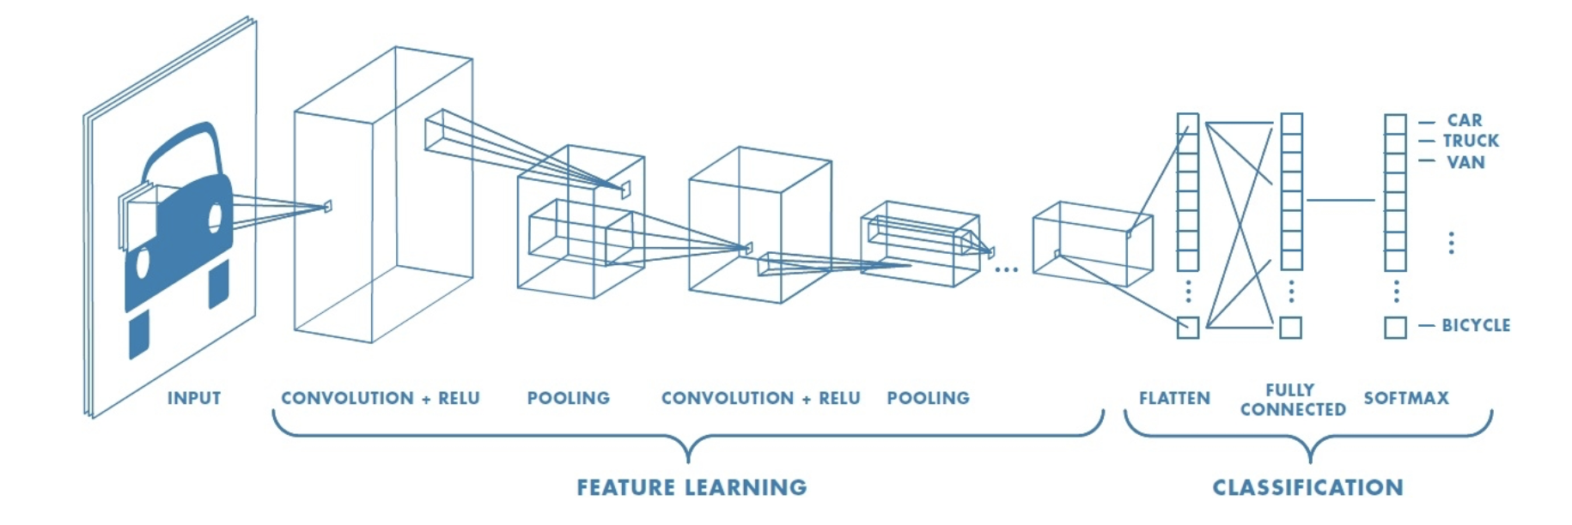
In this process, we take a dataset, apply linear transformations, and then get a set of ranked images.
An overview of the standard process:

Slide 7
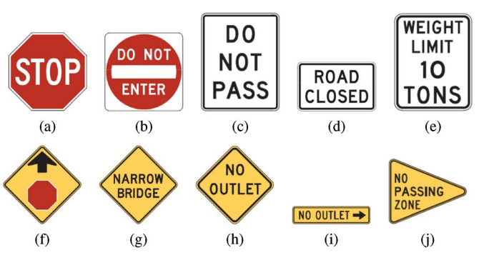
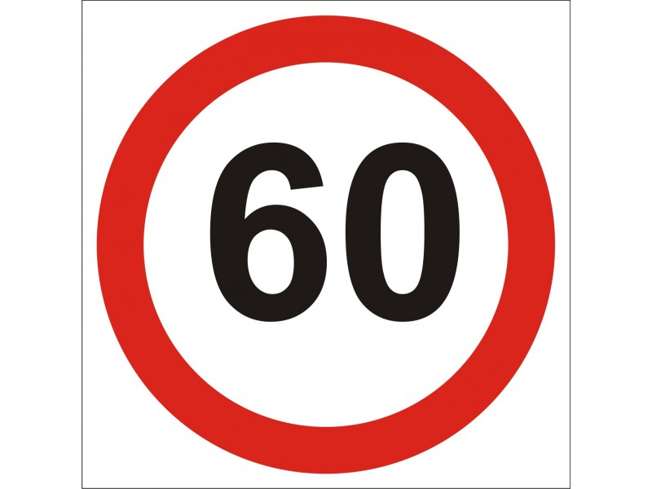
Prepare the image dataset
01
Collect images
How can linear algebra be applied to images?
Consider each image as a matrix of pixel values with 2 dimensions: width and height or rows and columns.
A single pixel value can be range between 0 and 255 units
Height: 4 units
(Pixels)
Width: 4 units
(Pixels)
Depth: 3 color channels
For color images, especially (Red, Green, and Blue) the presence of separate color channels introduces an extra dimension: ‘depth’, creating a three-dimensional input volume.
We will have 3 matrices associated with each RGB image, one for each color channel.
4 | 13 | 0 | 2
0
2
9
9 | 14 | 25 | 11
3
5
7
Collect a training dataset of traffic sign images and label them.
12 | 35 | 25 | 6
9 | 22 | 16 | 53
0 | 8 | 7 | 10
0 | 1 | 3 | 5
Height: 4 units
(Pixels)
Width: 4 units
(Pixels)
Notes:
Talking about color images.
0: 255 – amount of redness, greenness or blueness.
Each point in the matrix represents a pixel value.
(normally, we have 8 bit or 1 byte-sized pixels)
However, (Red, Green, and Blue),
Therefore,

Slide 8
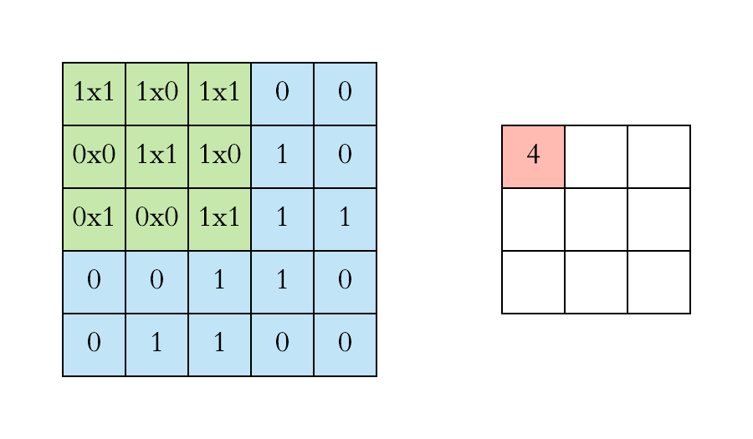
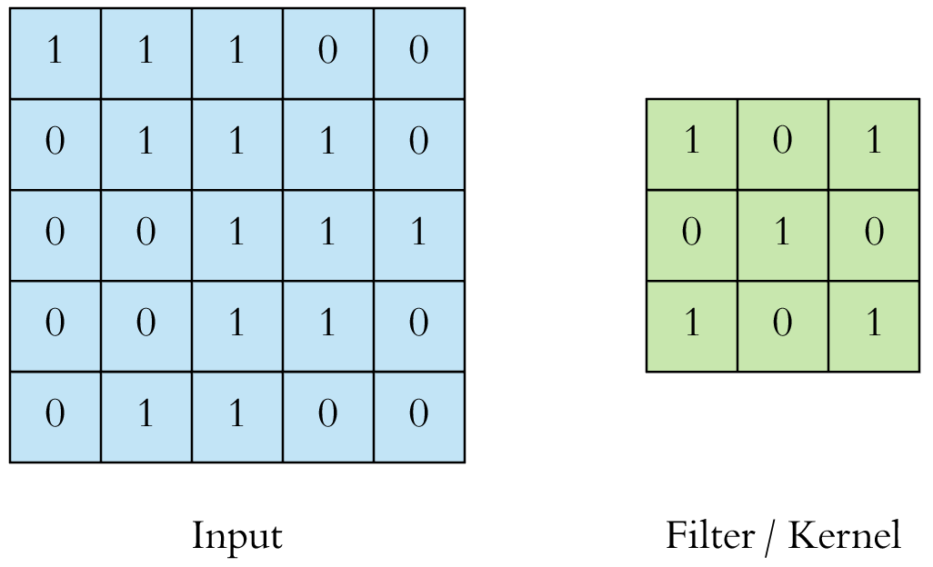
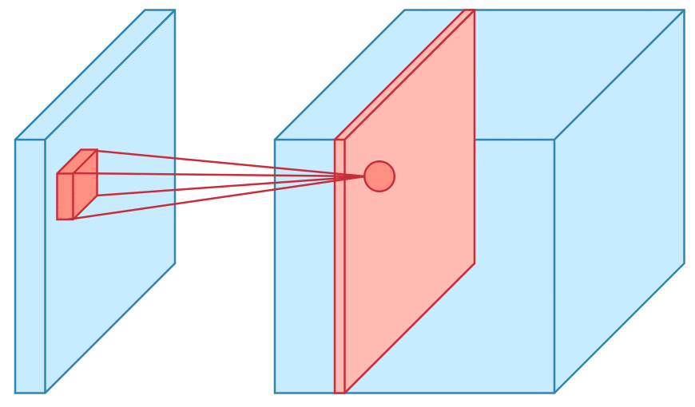
Convolution: combine 2 pain buckets > 1 bucket
Combine value of each layer with an input of the matrix
Each layer, there is a weight = feature matrix, feature map, filter, Kernel.
Input matrix (images). Set of matrices: feature that are learned.
Don’t multiply the matrix all on once, take receptive filed, slide it >> define the interval:
Multiply feature matrix by input (receptive field) >> new matrix: convolved feature.
Convolved feature >> apply to the next layers> reapt the process over again.
Set
02
Perform Convolution
Definition
What happens?
How can this step help ?
Convolution – set of mathematical operations that combine two sources of information (input and filter). (eg. take the two matrices and combine them together)
Input: Input image.
Filter: (kernel / weight) – smaller-sized matrix.
Compute the dot product between the filter and input matrix, then sum the dot product results to get the “convolved” value.
Enter that value in the next layer called ‘activation matrix’ (feature map / activation map)
Receptive field
Filter
0 | 50 | 0 | 0
0 | 0 | 50 | 0
0 | 0 | 50 | 0
0 | 0 | 50 | 0
0 | 0 | 50 | 0
0 | 50 | 0 | 0
0 | 50 | 0 | 0
0 | 50 | 0 | 0
Activation map
Multiplication and Summation = 0
The values in each matrix represent the shape of the sign. All other values outside the ‘line’ shape will be 0.
Take the ‘filter’ and perform the dot product with each part of the input images.
If the receptive field does not exist, then the dot product value = 0, meaning it is irrelevant.
.
Input matrix: 3 dimensional
Features that are learned: edge shapes, more abstract shapes.
Multiply the receptive field
Combine Kernel + Input >>
Activation Map | Feature Map
Notes:
Activation maps indicate ‘activated’ regions, i.e. regions where features specific to the kernel have been detected in the input.
The real values of the kernel matrix change with each learning iteration over the training set, indicating that the network is learning to identify which regions are of significance for extracting features from the data.
the activation matrix.
The patch selection is then slided (towards the right, or downwards when the boundary of the matrix is reached) by a certain amount called the ‘stride’ value, and the process is repeated till the entire input image has been processed. - The process is carried out for all colour channels.
It means irrelevant part = 0, only the relevant parts left.

Slide 9
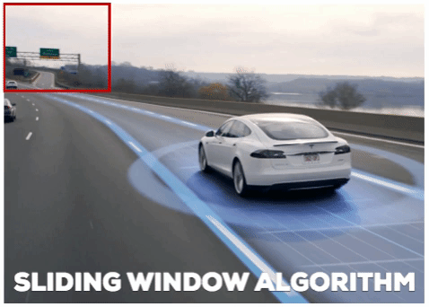
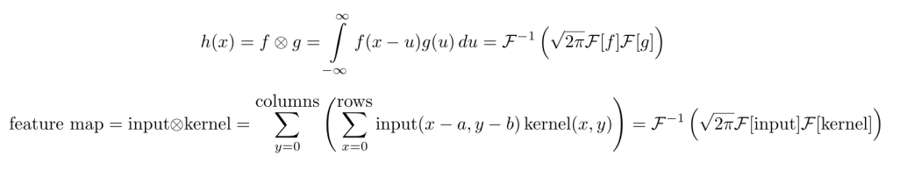
02
Perform Convolution (cont.)
How can this step help ?
Receptive field
Filter
0 | 50 | 0 | 0
0 | 0 | 50 | 0
0 | 0 | 50 | 0
0 | 0 | 50 | 0
0 | 0 | 50 | 0
0 | 50 | 0 | 0
0 | 50 | 0 | 0
0 | 50 | 0 | 0
Multiplication and Summation =
50*0 + 50*0 + 50*0 + 50*0 = 0
Math Function

Slide 10
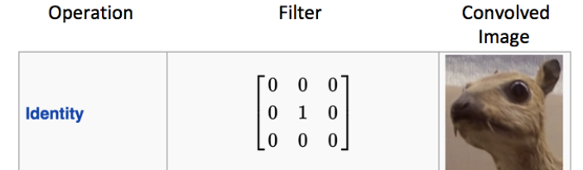
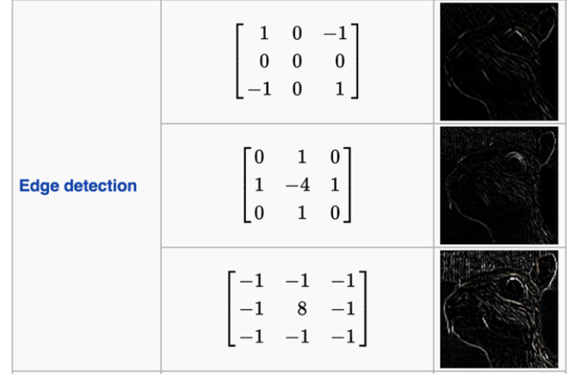
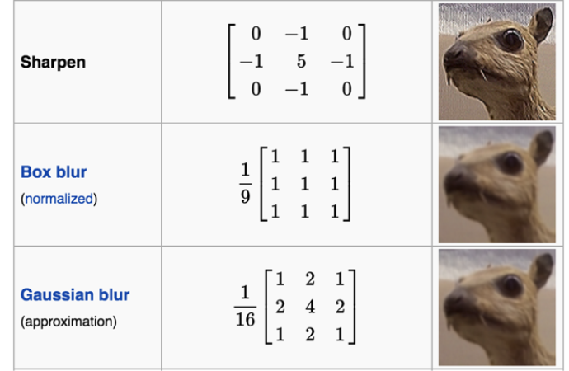
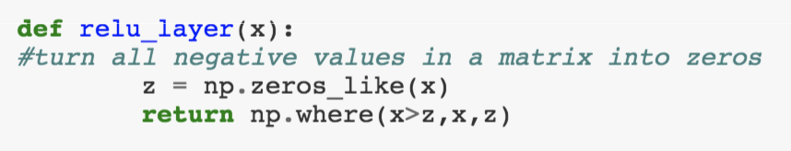
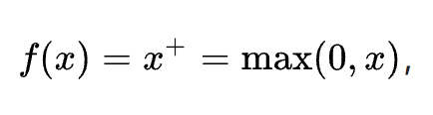
03
ReLU Normalization
Simplify the math and make computations more efficient
Why do we have negative numbers?
ReLU = Rectified Linear Units
ReLU is a type of activation function used in deep neural networks.
It is also known as ‘nonlinearities’ since it can learn both linear and non linear functions.
What does reLU Normalization do? It turns all the negative numbers in the matrix to 0.
We go from a stack of images to a stack of images with no negative values.
Since we have different filters in every layer, the values of the filter matrix are different and the signs of the values are based on the type of operation, thus creating negative numbers.
Math Function
Notes:
Question: why images get the negative number?
This slide should show the matrices that turn negative number to 0
https://arxiv.org/pdf/1803.08375.pdf
For more context, rectifiers in artificial neural networks are defined as the positive part of the below argument, where x is the input to a neuron.
A unit employing the rectifier is also called a rectified linear unit (ReLU).^{[7]}
Rectified linear units find applications in computer vision^{[3]} and speech recognition^{[8][9]} using deep neural nets.
https://en.m.wikipedia.org/wiki/Rectifier_(neural_networks)

Slide 11
Need to explain what is spatial
04
Pooling / Down Sampling
Keep the most relevant part of the image matrix
How does it work?
Pooling reduces the dimensions (Width x Height) of the Input Volume for the next Convolutional Layer. In other words, we only want to keep the most relevant part of the image matrix.
Performing pooling does not affect the depth dimension of the Volume.
This example shows the Max Pooling method, although two other ways are through L2 Norm Pooling and Average Pooling.
4 | 6 | 1 | 3
0 | 8 | 12 | 7
2 | 3 | 16 | 90
1 | 46 | 78 | 27
8 | 12
46 | 90
35 | 28 | 27 | 6
13 | 11 | 16 | 60
2 | 9 | 15 | 10
5 | 11 | 1 | 20
35 | 27
11 | 20
9 | 7 | 10 | 13
20 | 47 | 19 | 7
12 | 39 | 16 | 0
7 | 6 | 54 | 2
47 | 19
39 | 54
9 | 7 | 10 | 13
20 | 47 | 19 | 7
12 | 39 | 16 | 0
7 | 6 | 54 | 2
47 | 47 | 19
47 | 47 | 19
39 | 54 | 54
Stride: 2
Stride: 1
Notes:
After 2nd step: We have multiple images >> huge!!! + pretty big matrix >>
What we need to do? Take the important part of the matrix.
Reduce computational complexity
Pixel intensity >> highest pixel intensity
Once we get the activation map in Step 2 – convolution, we will reduce the dimension of the matrix by apply pooling (reduce computational complexity).
However, max pooling has been favored over others due to its better performance characteristics.
The transformation is either performed by taking the maximum value from the values observable in the window (called ‘max pooling’), or by taking the average of all the values, or even L2 norm.

Slide 12
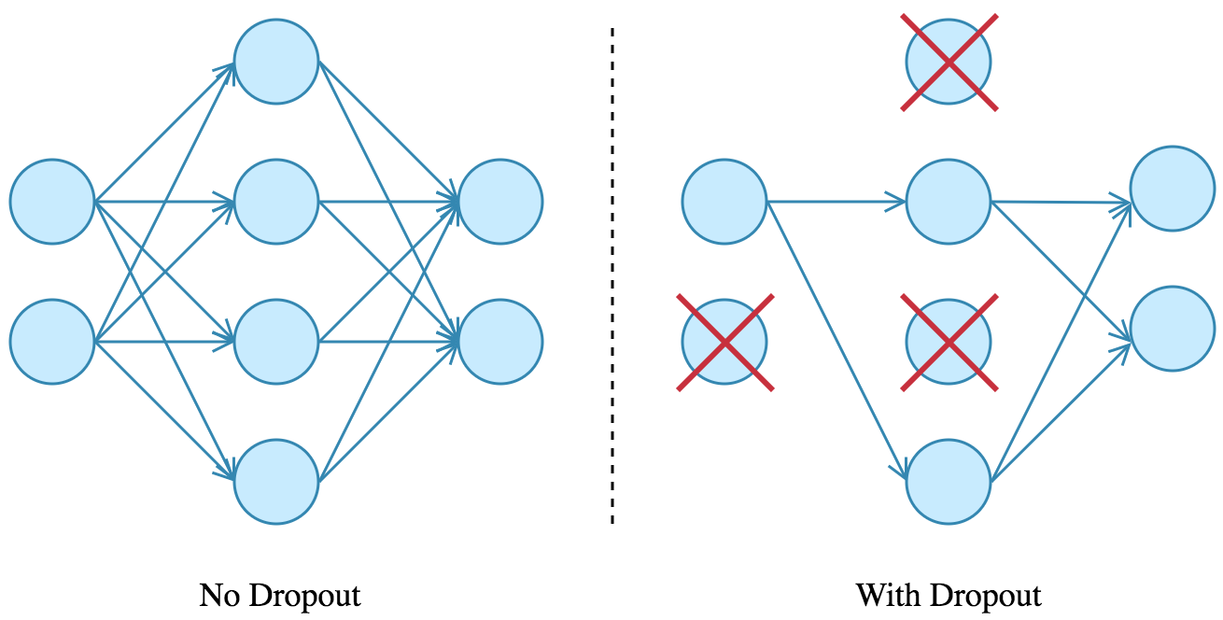
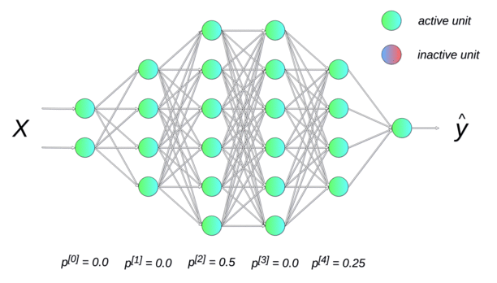
05
Regularization and Dropout
What is it and why do we need this step?
Neural networks are more prone to overfitting due to their complexity, and regularization is a technique to increase generalization ability & minimize overfitting (noise) in training data by slightly modifying the learning algorithm.
Regularization techniques.
using dropout on a neural network
pruning a decision tree
adding a penalty parameter to cost function in regression.
Matrices for each weight value are converted to 0 randomly at some layer
→ new pathways.
→ better generalized
input layer
output layers
hidden layers
12

Slide 13
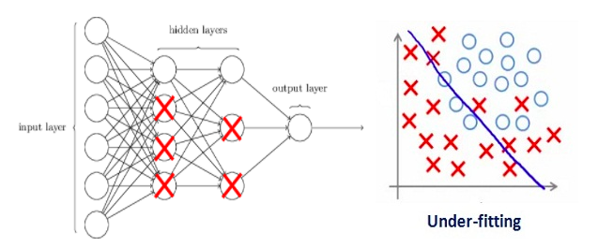
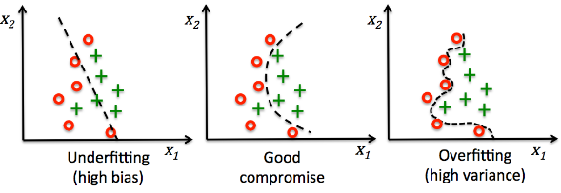
05
Regularization and Dropout
How does it work?
hidden layers
Regularization term increases in the network
→ larger matrices coefficient
→ smaller weight matrices
→ simpler models
→ reduce overfitting
output layers
input layer
If the regularization coefficient is too large, then some of the weight matrices are nearly equal to zero, which will result in simpler linear network and underfitting model.
13
Notes:
Dropout is usually preferred in large neural network structure in order to introduce increased randomness.

Slide 14
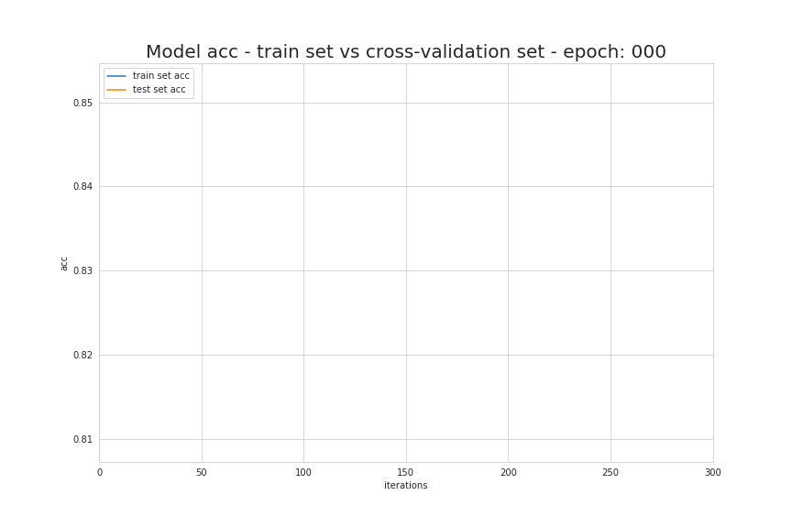
05
Cross Validation – Early Stopping
What stop training on model?
Early stopping is a cross-validation strategy that keeps one part of the training set as the validation set.
Stop training on model before the model starts overfitting
As the performance on the validation set gets worse, training on the model can be stopped immediately.
Notes:
It’s likely that overfitting will occur if a model does much better on the training set than on the test set.

Slide 15
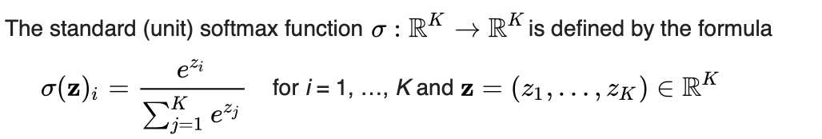
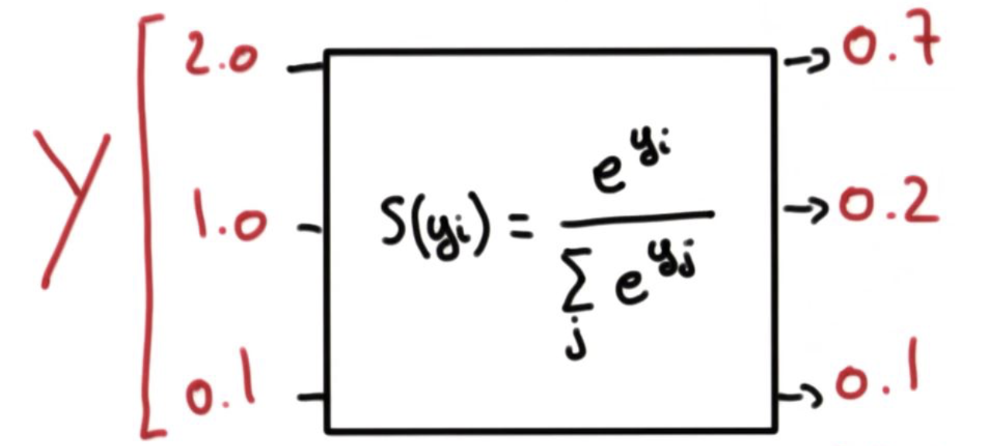
06
07
Probability conversion
Traffic Sign Ranking by Probability
How do we determine which images in our dataset are most similar to the query?
Transform each value in the image matrix (input) into a probability using the softmax function, which assigns it a value from (0,1) such that all components add up to 1.
Each probability determines the likelihood that the input image is similar to the traffic sign in the dataset.
Rank this in order from highest probability to lowest.
The image with the highest probability is the output.
Notes:
Each probability is a probability for a specific class: one way direction, 60mph limit sign…
What we need to do? Take max value – the most likely class.
Example: 0.7 means 70% that image is a one way direction sign. Then, we can conclude it is a one way direction traffic sign.

Slide 16
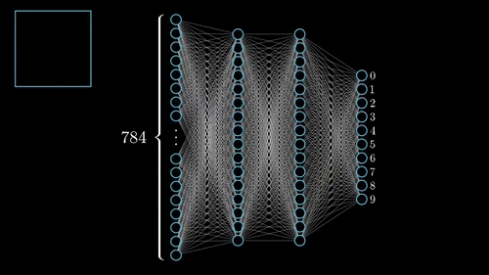
That is how image recognition works!

Slide 17
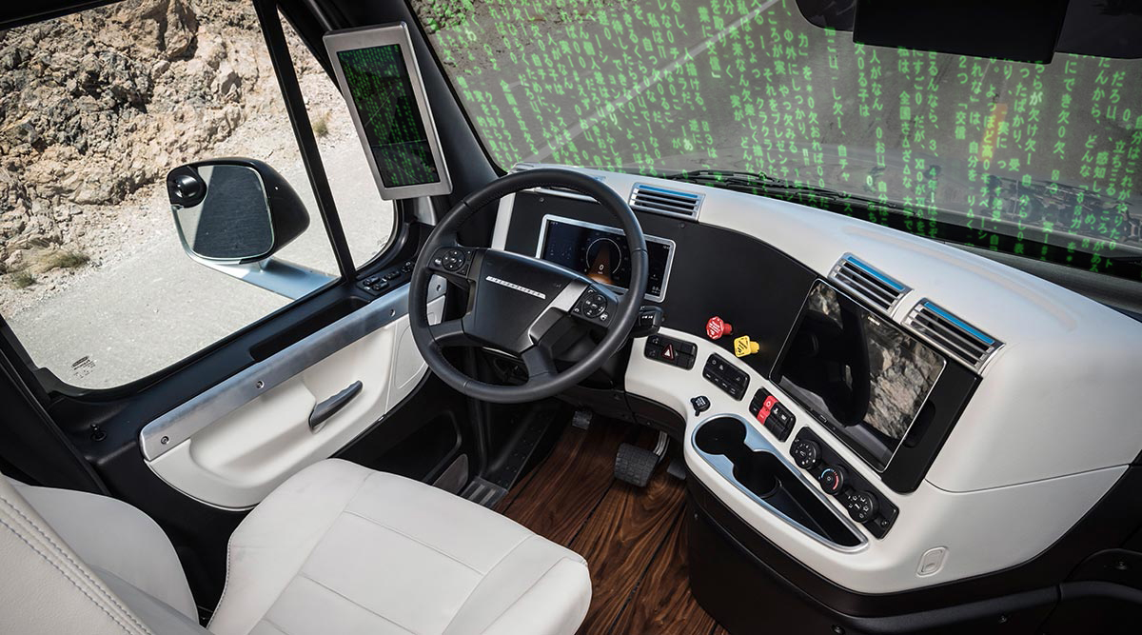
Simple Example Walkthrough
17

Slide 18
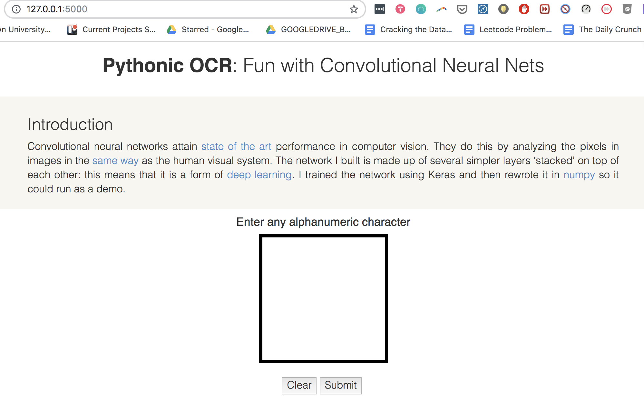
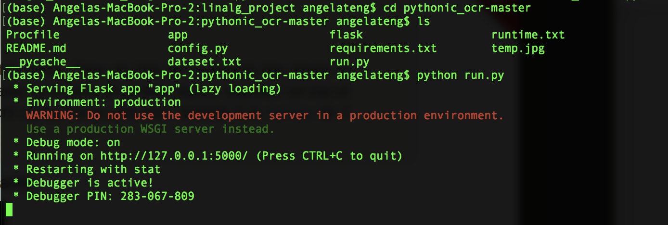
Image Recognition with Numpy and Flask Demo on Handwriting Dataset
We used a tutorial created by Siraj Raval and Greydanus to create a image recognition website run in pure numpy, and wrapped in a flask app.
For our group’s code, please see our github: https://github.com/angelaaaateng/LinAlg_Project
For Greydanus’s live site deployed on Heroku, please see the following link: https://pythonic-ocr.herokuapp.com/
Notes:
Network of self driving cars
Bigger datasets
https://pythonic-ocr.herokuapp.com/

Slide 19
Recommendations and Future Applications
Notes:
LINEAR ALGEBRA APPLICATION DESCRIPTION

Slide 20
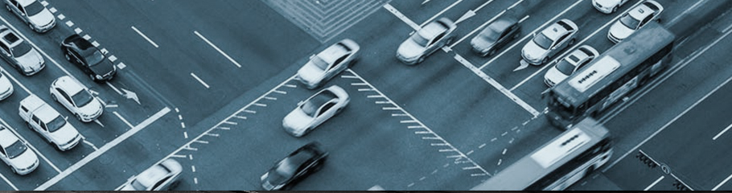
RECOMMENDATION
Deeper exploration into traffic and safety
Traffic optimization using image recognition
Other aspects of autonomous driving vehicles
Larger and more diverse datasets
Specific traffic datasets by country
Medical images for disease prevention and detection
Unbiased facial recognition
20

Slide 21

THANK YOU!
QUESTIONS

Slide 22
References + Appendix

Slide 23
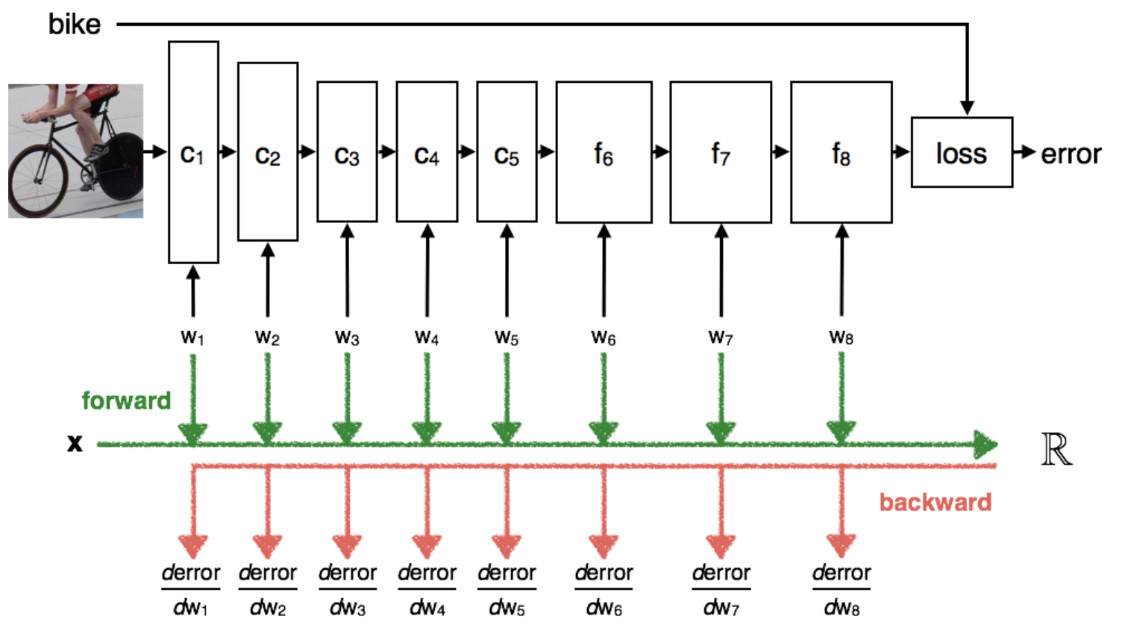
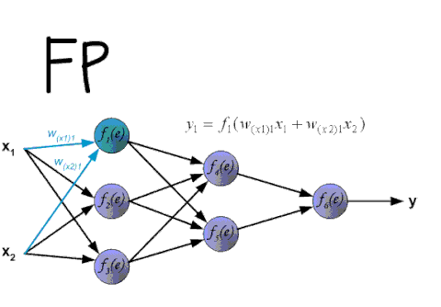
08
How to train the data? How do machines learn?
Gradient descent
Back propagation
Using gradient descent : back propagation
How do the machine learn the weight, the filter…
Errors in computing
Human label
Put the image in the 60 mph label. Pass it through each layer dot product action
Compare the prediction value with actual value. If any errors existed, take the error, with respect to each weight value compute partial derivative of the error, going backward to the network.
Gradient value
Which values we should use, which window or interval >> best practices! We do not cover in this presentation

Slide 24
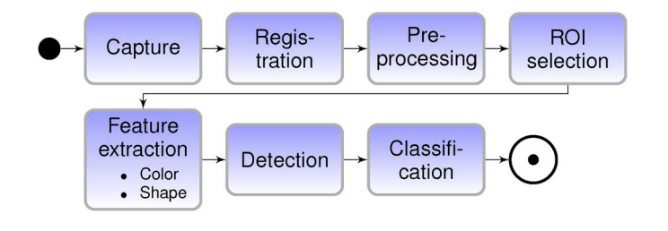
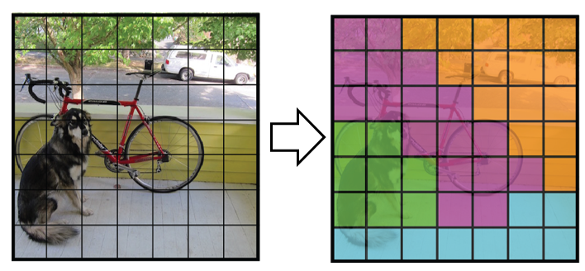
Computer Vision as an Application of Linear Algebra
Object Detection Process:
Image classification → determining what the objects in the image are
Image localization → providing the specific location of these objects
To perform image classification, a convolutional neural network is trained to recognize various objects, like traffic lights and pedestrians.
Using a CNN through a YOLO algorithm (You Only Look Once)
Split up the image into a grid and run the entire image through a CNN
Notes:
https://github.com/aarcosg/traffic-sign-detection/blob/master/Run_models_on_new_images.ipynb
https://github.com/aarcosg/traffic-sign-detection
https://ieeexplore.ieee.org/stamp/stamp.jsp?arnumber=7116530
We end up with a class probability map, which gives us the probabilities for each grid cell being a specific object. YOLO works because it returns the predictions of small portions of the entire image so it doesn’t need multiple window sizes and run-throughs.

Slide 25
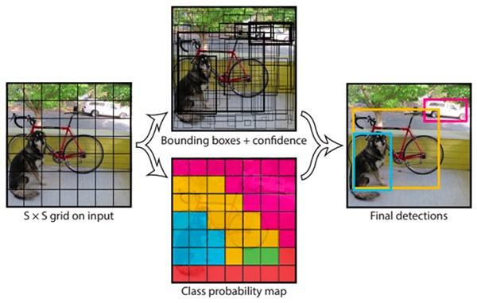
Computer Vision as an Application of Linear Algebra
Object Localization is used to determine where each object is (in relation to the entire image) using bounding boxes.

